Slide 1

IAIA Midterm Project 2024
IAIA Project #1
Turbo Fan Engine Degradation RUL estimation using ML
School of Mechanical and Control Engineering Kwak Jin(21900031)
Kim Sunwoo(22000090)
24.10.04
Industrial AI and Automation
Prof. Young-Keun Kim
Notes:
Hello every one, Im presenter sunwoo and my prartner is 곽진. today im going to present our project on ‘제목’

Slide 2
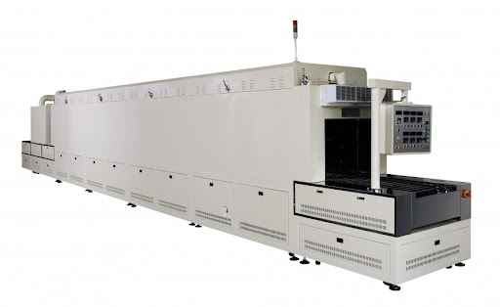
1. Background
1) Hot-Air Drying Process
Ensures that the film and protective agents adhere stably to the metal surface after plating
Completely dries moisture from the product surface.
2) Process Defects
High power consumption using coil. → Overheating, Irregular temperature transmission → Poor product quality
3) Defects Detection
Coil fault may cause issues with the cooling motor → Vibration patterns changes.
The goal is to identify these changes to diagnose the issue early on.
Notes:
First the back ground of
primarily high power consumption and coil defects that lead to overheating and irregular temperature transmission.

Slide 3
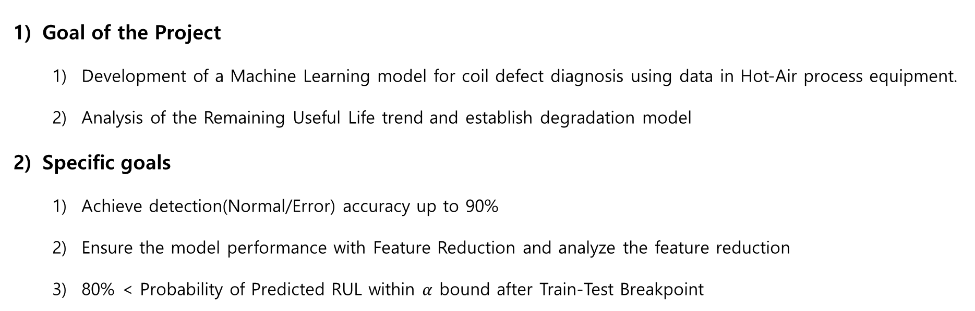
2. Problem Statement
Goal of the Project
Development of a Machine Learning model for coil defect diagnosis using data in Hot-Air process equipment.
Analysis of the Remaining Useful Life trend and establish degradation model
Specific goals
Achieve detection(Normal/Error) accuracy up to 90%
Ensure the model performance with Feature Reduction and analyze the feature reduction
80% < Probability of Predicted RUL within $α$ bound after Train-Test Breakpoint
Notes:
The main goal of our project is to develop a machine learning-based model to detect coil defects in hot-air drying process equipment. Additionally, we aim to predict the Remaining Useful Life (RUL) of the equipment to proactively address potential failures.
Specifically, we want to achieve a detection accuracy of over 90% for identifying defects and ensure that 80% of our RUL predictions fall within an acceptable margin of error after our model is trained and tested. This will not only help us prevent coil-related failures but also ensure better equipment management and productivity.

Slide 4
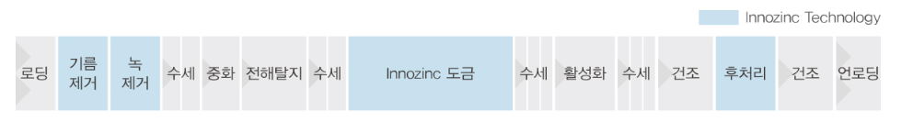
3. Dataset
Dataset name : AI dataset for early detection of equipment abnormalities
Data Measurement
PLC data (Sampling period: 5 [sec])
Sound data
Data Categories
Numerical Data : Temperature, Current
Sound Data : 185 data, 30sec per track. Subdivided into Error and Normal
Error Lot list: Process number, Error Number
5) Data type
Supervised Learning-Based Data
Time series data
Numerical(Float/ .csv) and Sound data(.wav)
6) Data Output
- Classification: Normal / Error
7) Data input
 | Attribute | Explain
Input | Index | Auto-generated value when collecting data
 | Process | Tracking the process by assigning the same number to the same process
 | Time | Recording time down to seconds in the format (H:MM:SS)
 | Temp | Temperature within the hot-air drying system
 | Current | Current within the hot-air drying system
Error | 1-11 | Error Number

Slide 5
4. Method
Data Preprocessing
Feature Extraction and Analysis
Feature Selection /Reduction
Discussion & Conclusion
RUL Estimation
Fault monitoring and warning

Slide 6
5. Expected outcome
The process is used in various fields. (e.g. electronic component coating, automotive paint processes, and ceramic processes) Applying model to hot-air process may prevent product damages caused by coil failures.
Before: Difficulty on immediate problem check of coil defects on-site on real-time base. After: Respond quickly to equipment fault → Benefits on equipment management and productivity.

Slide 7
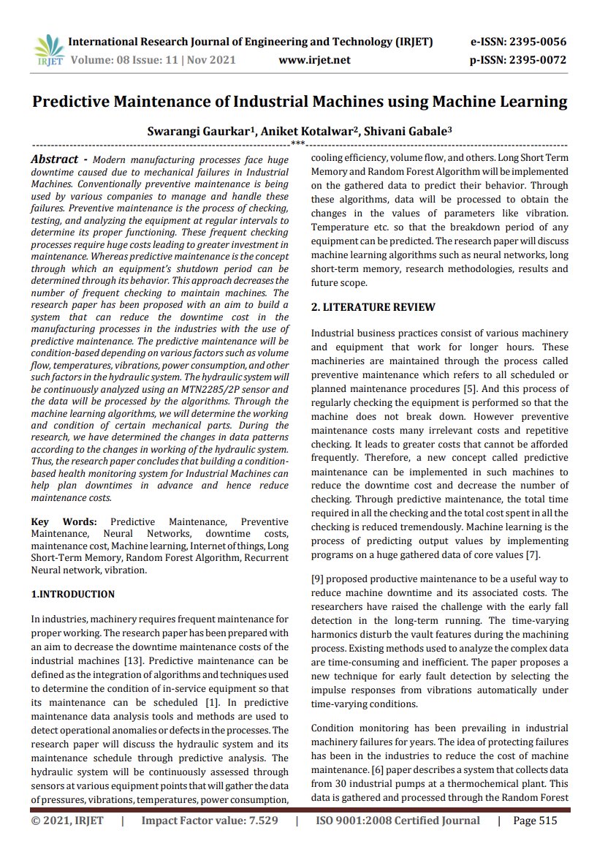
6. Paper Review
1) Paper information
Gaurkar, Swarangi, Aniket Kotalwar, and Shivani Gabale. "Predictive maintenance of industrial machines using machine learning." Int Res J Eng Technol (2021).
2) Explaination
Sensor data of hydraulic system : pressure, vibration, temperature, power consumption, etc.
RUL of the hydraulic system is predicted by ML methods e.g. LSTM or random forest model.
3) Application on the Project
Predicting the RUL of a facility using:
Vibration(counterpart of sound)
Temperature
Power(counterpart of current) data

Slide 8
7. Schedule

Slide 9
8. References
[1] (주) KEMP, Innozinc 세라믹 아연도금, http://kempkorea.com/
[2] Gaurkar, Swarangi, Aniket Kotalwar, and Shivani Gabale. "Predictive maintenance of industrial machines using machine learning." Int Res J Eng Technol (2021).

